Slide 1
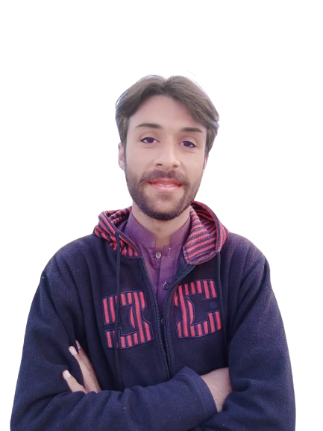
Complex Task Series
Problem Number 45

Slide 2
Problem Statement
Write a Python Program to write text on picture

Slide 3
Algorithm
Step1: Import PIL Library
Step2: Read an image
Step3: Select image, on which want to write
Step4: Write a text on image
Step5: Save
Step6: Show image
END

Slide 4
Assignment
Write a Python Program to join two pictures.

